Slide 1
ELIXIR
Jerry Lanfear, ELIXIR CTO (jerry.lanfear@elixir-europe.org)
ELIXIR, on experiences in ELIXIR in developing a collaborative infrastructure with
particular focus on governance and sustainability
EBIC2, Copenhagen
July 26th 2018

Slide 2
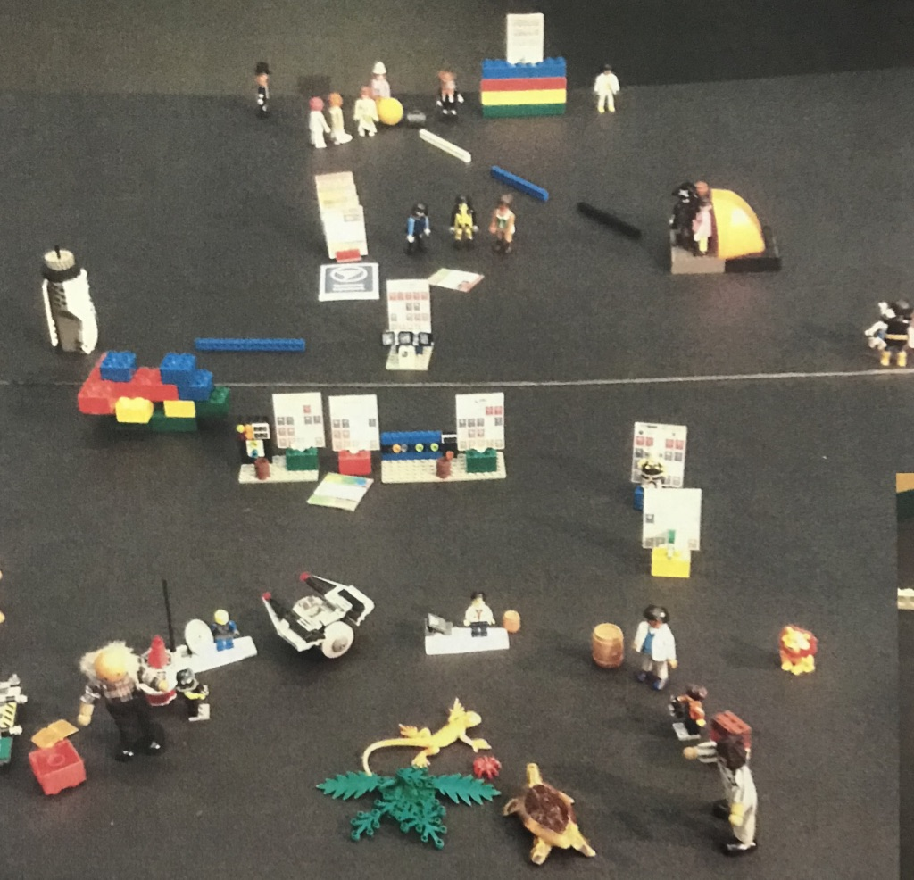
ELIXIR – the short version

Slide 3
ELIXIR connects national bioinformatics centres and EMBL-EBI into a sustainable European infrastructure for biological research data
medicine
agriculture
bioindustries
ELIXIR underpins life science research – across academia and industry
environment

Slide 4
In 2023: Universal access to a biological data infrastructure that drives research and the bio-economy
Research - Healthcare data interface
Genomics data linked to phenotype for population
Responsible sharing – GDPR compliant and auditable
European Open Science Cloud: discoverability, access, sharing and analysis
High content phenotyping at different time and spatial scales

Slide 5
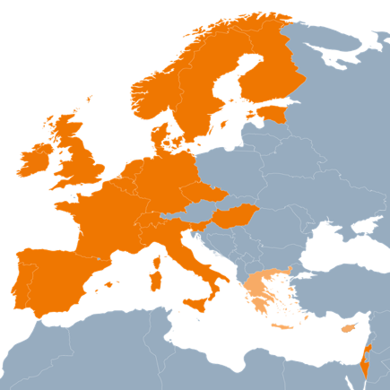

Slide 6
Brief History of ELIXIR – infrastructure development
ELIXIR Launch
6 Members
2015:
15 Members
2017:
21 Members
2014:
12 Members
2016:
20 Members
MoU between prospective member states, interim financing
ESFRI evaluation
AEG evaluation
Director recruited
EXCELERATE 2015-2019
ELIXIR Prep
Scientific Programme 2019-2023
Scientific Programme 2014-2018

Slide 7
ELIXIR Hub Staff

Slide 8
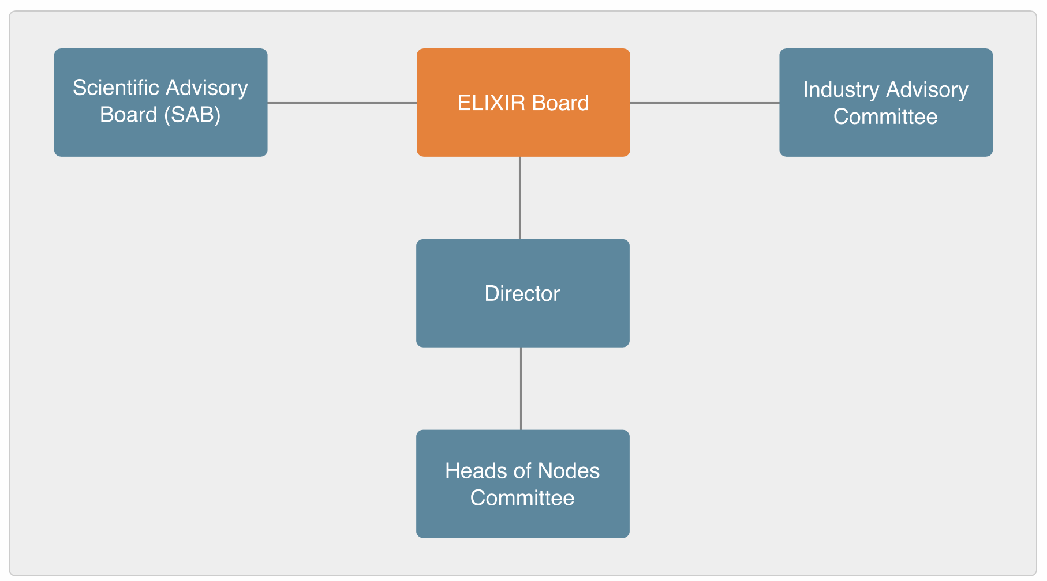
Governance

Slide 9
How is ELIXIR constructed to facilitate our mission?
Organizational
Financial
Technical

Slide 10
How is ELIXIR constructed to facilitate our mission?
Organizational
Financial
Technical

Slide 11
ELIXIR’s Organizational Constructs
Organisational construct | Description
Platforms | The established ELIXIR technical platforms of Compute, Data, Interoperability, Tools and Training
Communities | ELIXIR’s growing complement of experts and services for scientists in a particular domain
Nodes | The 22* member states plus EMBL-EBI
Strategic collaborations | A growing number of critical external partners that are becoming increasingly important for delivering the technical strategy e,g, other ESFRIs, GA4GH
*- includes Greece and Cyprus, currently observers

Slide 12
ELIXIR : 5 platforms of shared services led by leading European scientists

Slide 13
Pre-existing Communities - the “Use Cases”
Human Data Communities

Slide 14
New Communities - Technologies and Services
Proteomics
Metabolomics
Galaxy
Development and maintenance of sustainable
proteomics tools and data resources
To identify and address the principal challenges within metabolomics within the scope and mission of ELIXIR
To monitor and foster the use of Galaxy in ELIXIR
Agreed September 2017

Slide 15
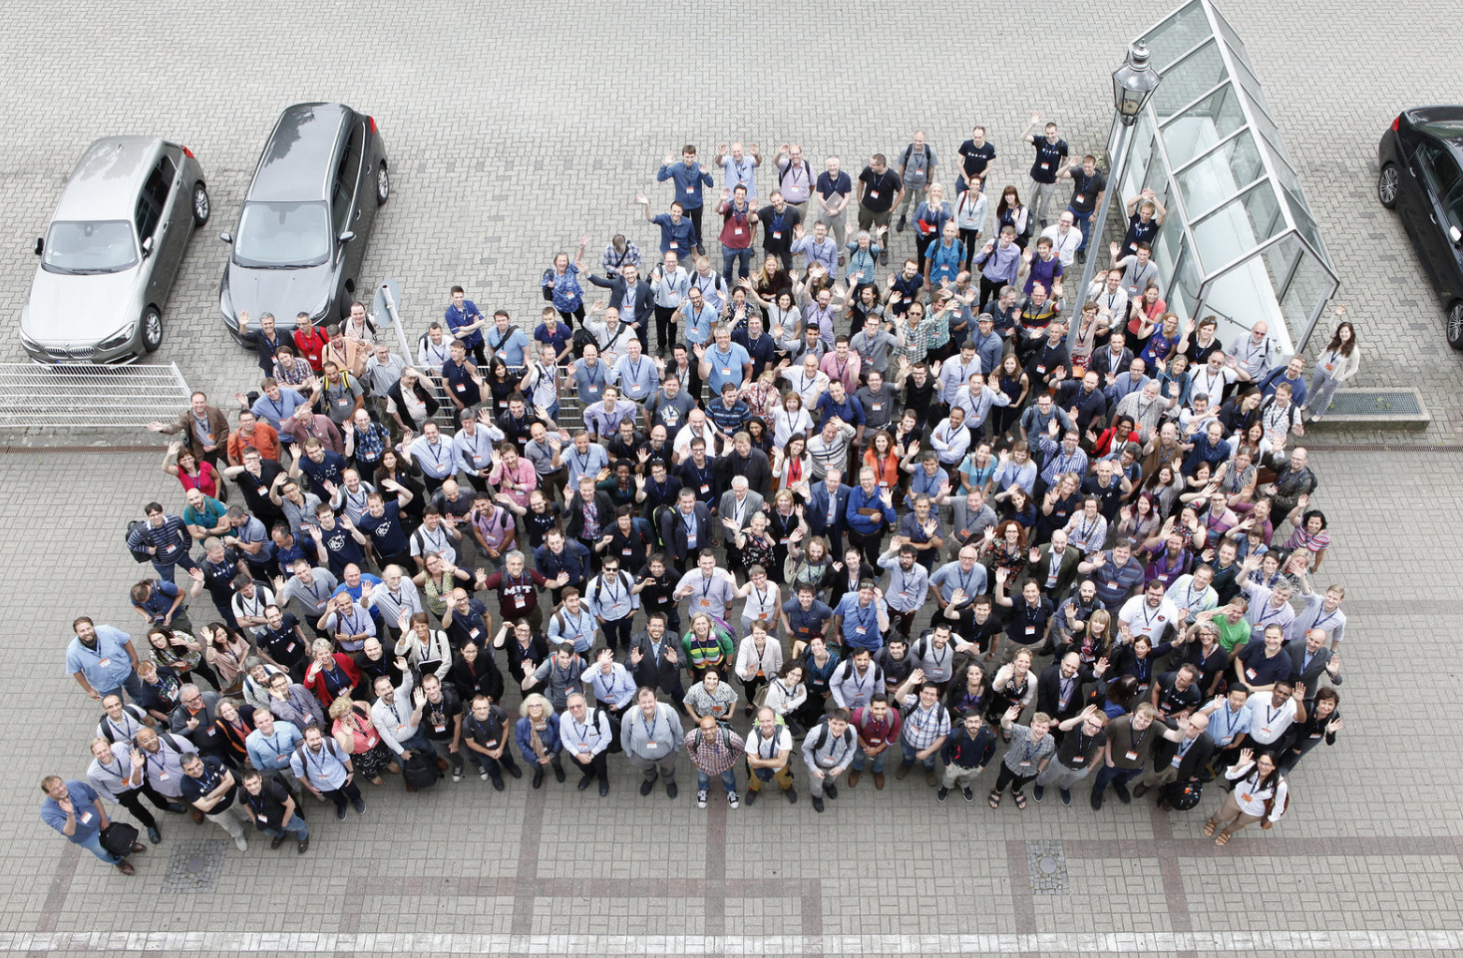
Nodes

Slide 16
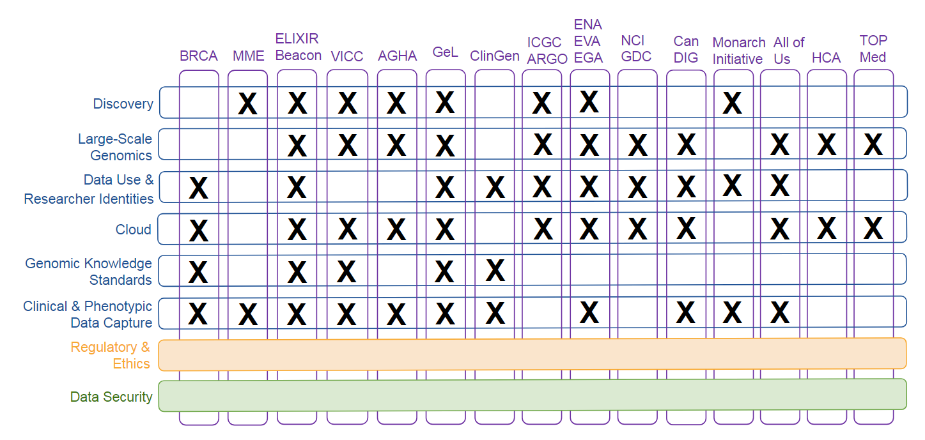
ELIXIR & GA4GH
GA4GH Workstreams
Driver Projects

Slide 17
How is ELIXIR constructed to facilitate our mission?
Organizational
Financial
Technical

Slide 18
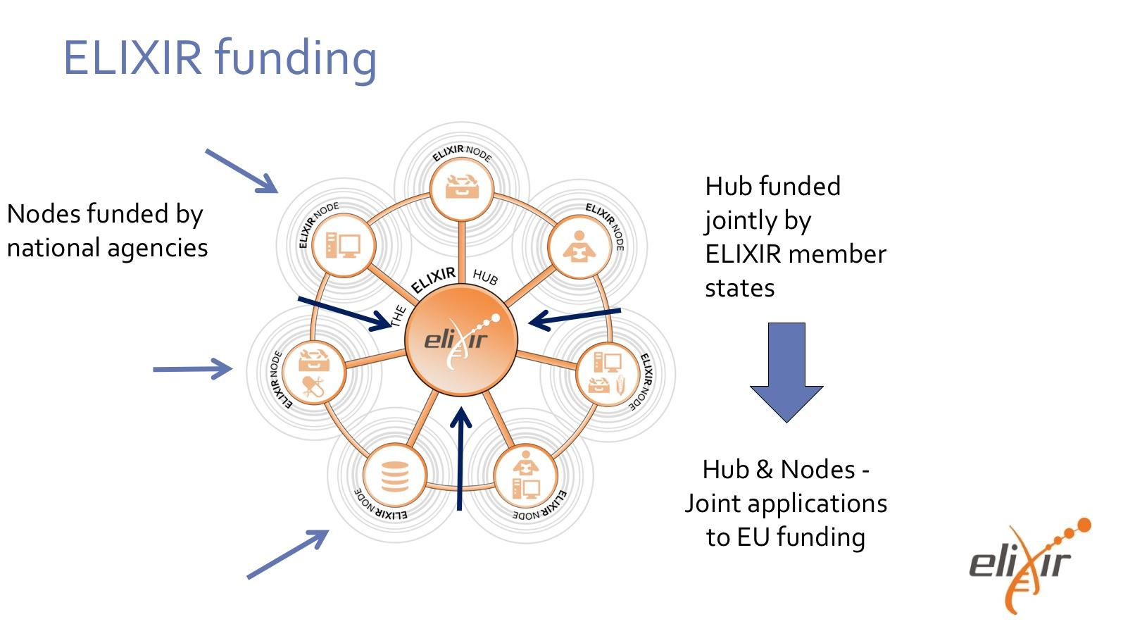
Commissioned
services
Commissioned
services
Commissioned
services

Slide 19
Commissioned Services – selected examples
Title | Platform/Community | Nodes
BioSchemas | Interoperability | UK, EBI, FR, BE, NL, IT
AAI production | Compute | FI, CZ
ELIXIR Beacons | Human Data | BE, EBI, ES, CH, NL, FI,SE, FR
Marine Metagenomics: towards user centric services | Marine Metagenomics | NO, EBI
Towards a distributed Ensembl | Data | SE, NO, EBI
https://www.elixir-europe.org/about-us/implementation-studies

Slide 20
How is ELIXIR constructed to facilitate our mission?
Organizational
Financial
Technical

Slide 21
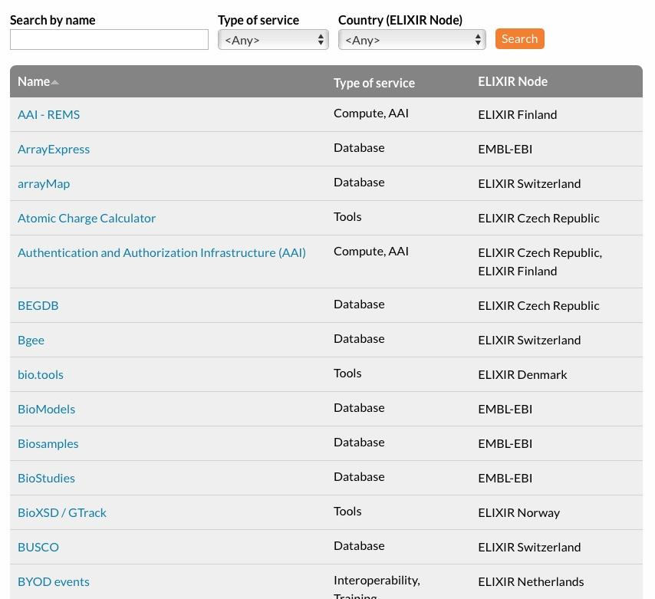
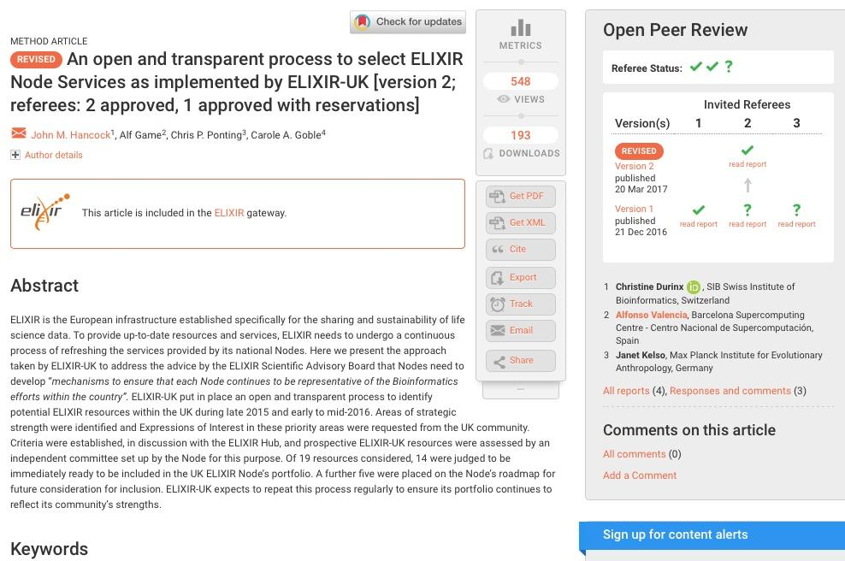
ELIXIR Services
Notes:
ELIXIR’s services include databases, tools, standards and how to achieve interoperability of standards, training courses, compute resources, data management support and industry cooperation and technology transfer. The list of services is constantly evolving
Data deposition: ELIXIR Nodes run several data deposition archives where researchers can save their data. Deposition is usually done online and is free as a public resource. The major deposition archives run by ELIXIR Nodes include ENA, EGA, PDBe, EuropePMC
Added-value databases : Added-value databases process, analyse and annotate data (adding comments and other information) from deposition archives and make them accessible to wider scientific community. The added value comes from data processing, additional annotation, or mapping to standardized vocabularies or ontologies (a formal specification of terms and relationships among them). They facilitate the discovery of useful data and the usage of it. Examples of the major knowledge-bases run by ELIXIR Nodes include: UniProt, Ensembl, OrphaNet
Using Compute services, researchers can carry out computationally intensive modeling and simulation studies and make the most of the big data revolution in the life science. Several ELIXIR Nodes offer Cloud computing services, which enable researchers use compute resources on-demand, without the need to manage their own hardware or datacenter in-house. Services currently available:
Computerome (ELIXIR Denmark,
ePouta, cPouta (ELIXIR Finland)
Embassy cloud (EMBL-BLI)
Training: ELIXIR Training trains European developers, trainers and researchers within ELIXIR communities. The developers are trained to get a better performance and use relevant methodologies to implement software. Trainers are trained to deliver courses to use ELIXIR services. Researchers are trained to effectively use the tools and services offered by ELIXIR. ELIXIR training portal TeSS collects training related materials - users can browse, discover and organise life science training resources aggregated automatically from ELIXIR Nodes and 3rd party providers.
Data management: Several ELIXIR Nodes offer practical help to research teams in developing and implementing their data management plans. The support ranges from practical help to research project in drafting their data management plans to services
Industry: ELIXIR's Innovation and SME programme is a series of specialised events that bring together operators of ELIXIR services with industry and SME representatives, who have the opportunity to learn how to effectively use the bioinformatics tools and services offered by ELIXIR.
Tools:

Slide 22
Core Data Resources – a data infrastructure
Scientific focus and quality of science
Curation level, benchmarking
Community served by the resource
Web statistics
Quality of service
Uptime, user support and training
Legal and funding infrastructure
Institutional support, use policy
Impact and translational stories
Foundational role
Legal &
funding infrastructure
Scientific impact
Quality
Community
Scientific focus
Impact
Indicators (Mandatory and optional)
Durinx C, McEntyre J, Appel R et al. Identifying ELIXIR Core Data Resources F1000Research 2016, 5(ELIXIR):2422
Notes:
e.g. Mandatory
IP addresses
Website page views
Mentions of Accession Numbers, Resources Names, Citation of Key papers in the literature (Europe PMC)
Open data statement (?)
e.g. Optional
Submission rates
Curational effort
FTP downloads
International Coordination

Slide 23
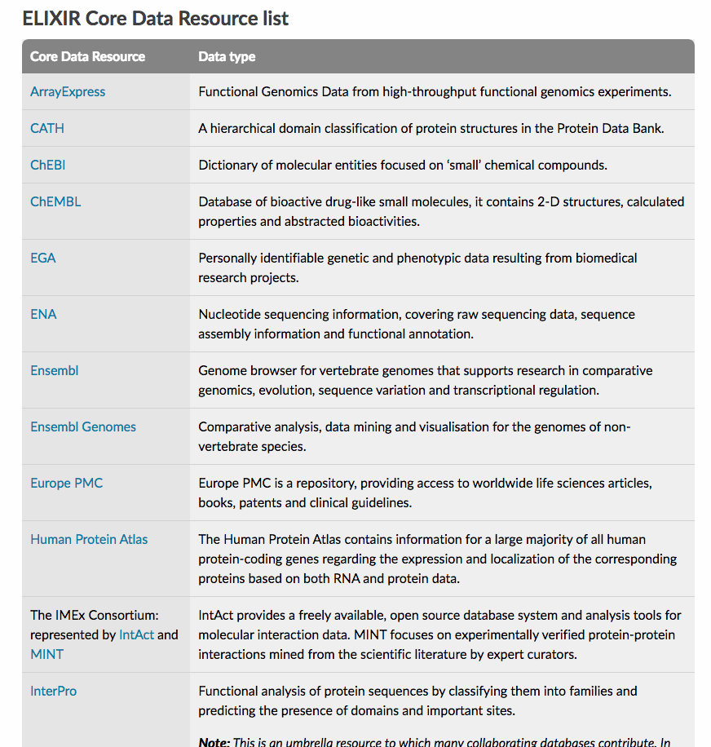
ELIXIR Core Data Resources
Set of European data resources of fundamental importance to the wider life-science community and the long-term preservation of biological data.
Agreed collectively by 21 Heads of Nodes
International collaborative effort
https://elixir-europe.org/platforms/data/core-data-resources
Durinx C, McEntyre J, Appel R et al. Identifying ELIXIR Core Data Resources F1000Research 2016, 5(ELIXIR):2422

Slide 24
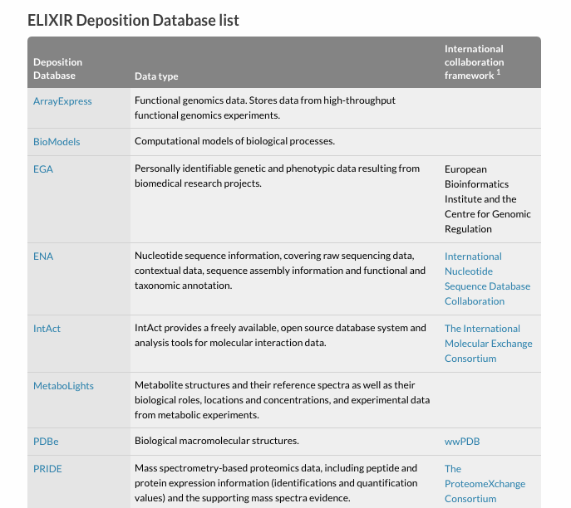
“Whenever possible, biological research data should be submitted to the recommended community deposition databases"
The ELIXIR Deposition Databases meet the technical quality and governance criteria expected of ELIXIR Core Data Resources
Agreed collectively by 21 Heads of Nodes
International collaborative effort
https://elixir-europe.org/platforms/data/elixir-deposition-databases

Slide 25
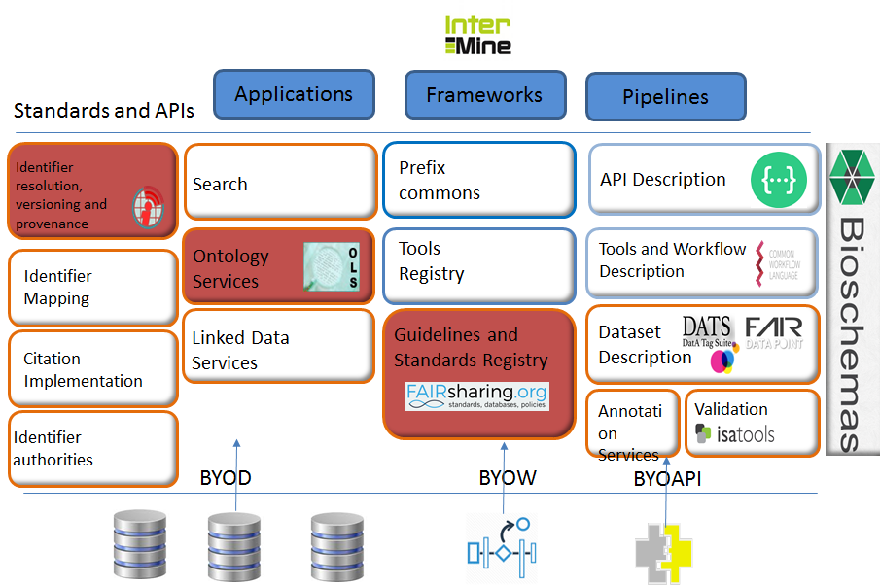
ELIXIR Interoperability Service Framework

Slide 26
Compute: ELIXIR Authorisation and Authentication Infrastructure
Enables life science researchers to use their institutional IDs to access services and data:
Reduced bureaucracy and costs
Improved vetting: federated identities provide greater confidence to the service and data providers
Regular updates: as researchers join leave institutions, their affiliation information is maintained regularly
Improved access to usage metrics: consistent use of accounts allows service providers to better analyse the use of their services
Applicable to other research infrastructures (CORBEL)

Slide 27
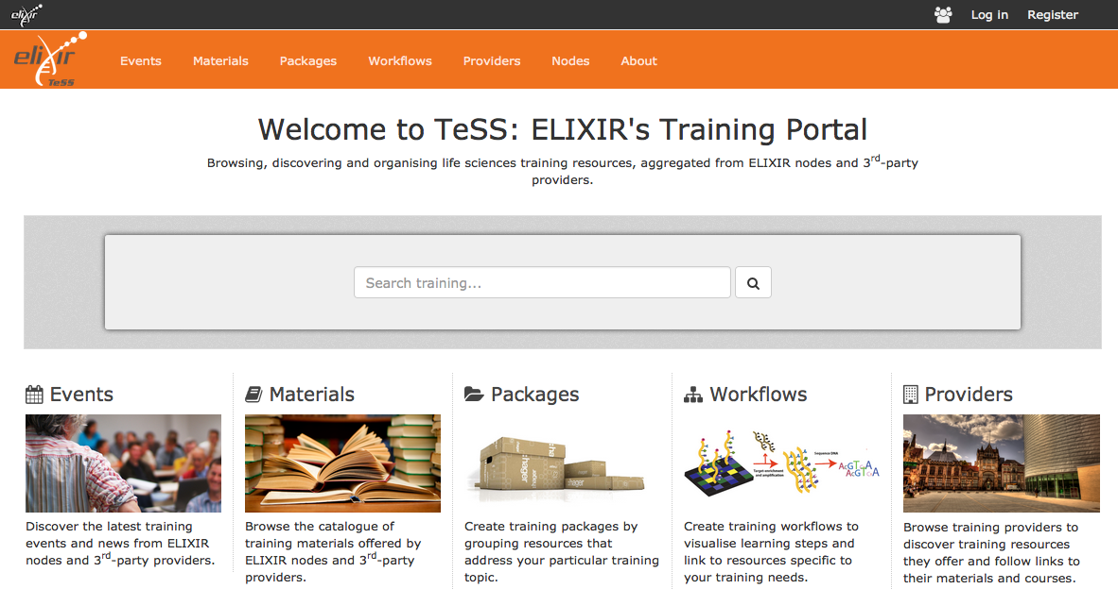
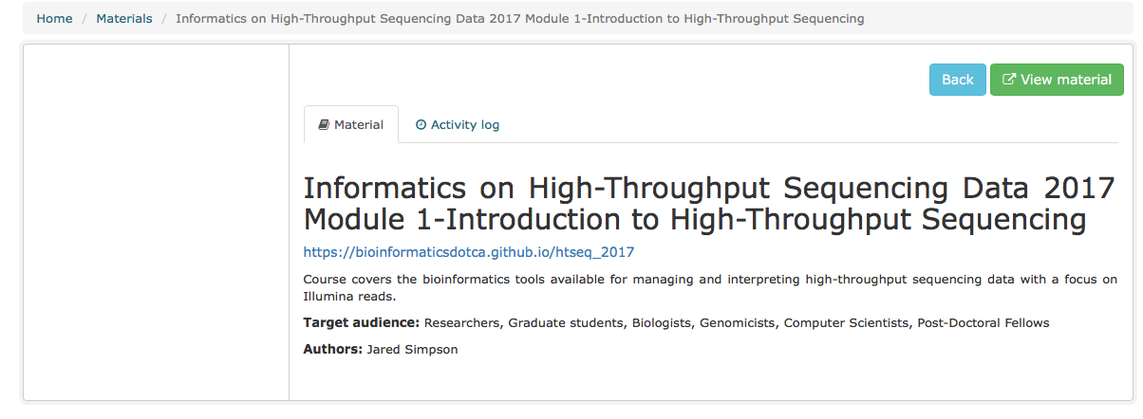
ELIXIR TeSS Portal (Training eSupport System)
Platform to disseminate, discover & package training resources, training materials and events – led by ELIXIR UK
Aggregating information from ELIXIR nodes and various 3rd-party content providers
http://tess.elixir-uk.org

Slide 28
Working with Agricultural and Plant research communities to drive data exchange and genome-wide analysis of crop plants
Population growth and climate change: major challenges to food security
ELIXIR Mission: facilitate genotype-phenotype analyses for crop and tree species
Develop standards for representation of genotypic and phenotypic data
Make data discoverable and interoperable through common APIs
Annotate and submit key exemplar datasets to relevant public archives
Develop reusable modules for visualisations
Disseminate best practices and tools to national projects
https://brapi.org/partners.php

Slide 29
Federation of human genome data: localEGA
Many national datasets from human
research participants needs to be stored locally
ELIXIR-EXCELERATE developing “localEGA” – shared metadata (FAIR)
and local data store (secure)
Linking local EGA to national clouds – and international access (ELIXIR-AAI)
Distributed computation and reproducible science: tools, workflows
and containers
Key collaborations

