Slide 1
GBIC2 – Realising the vision
Donald Hobern, GBIF Executive Secretary
Macropus robustus Gould, 1841, subspecies erubescens, Euro, Denham, WA, Australia, 10 January 2018

Slide 2
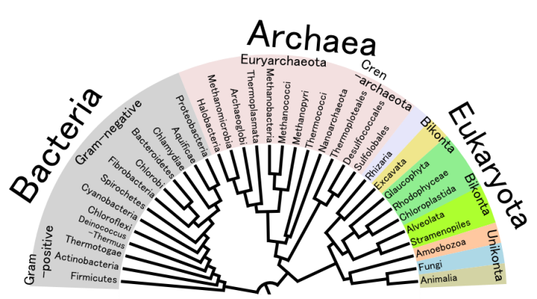
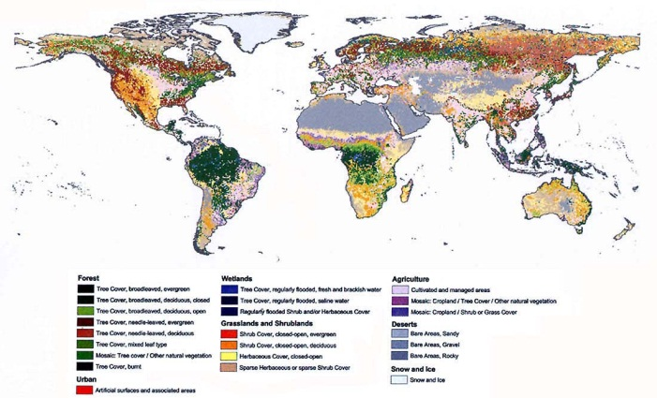
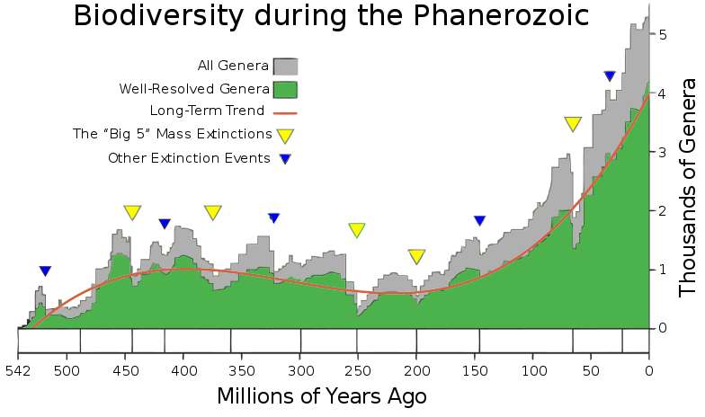
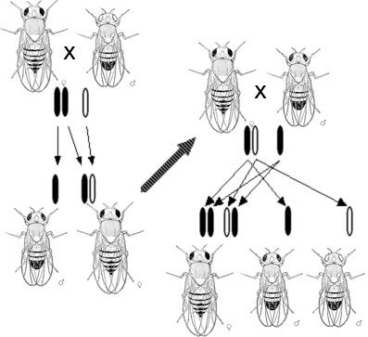
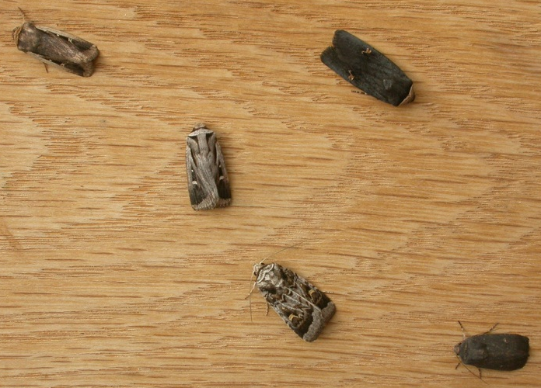
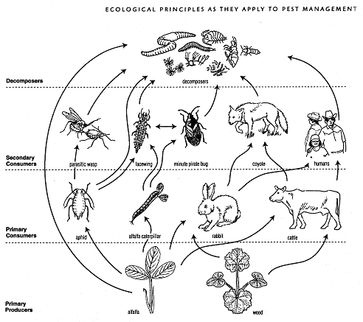
Complexity of biodiversity

Slide 3
Global Cooperation Matters

Slide 4
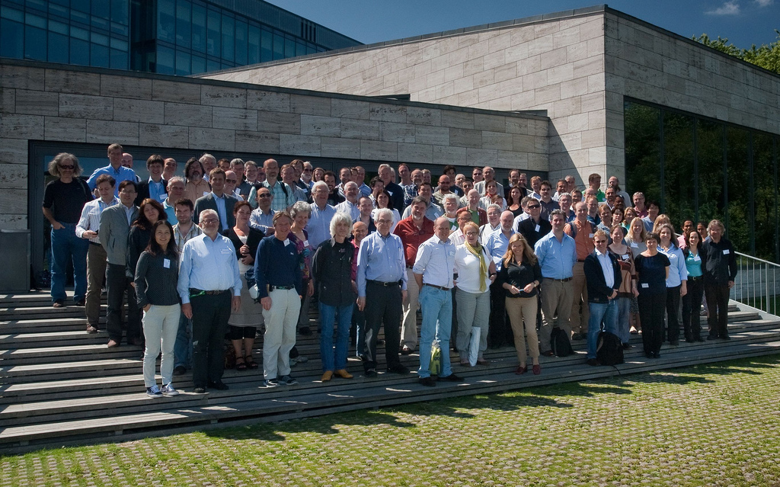
First GBIC in 2012
Copenhagen, Denmark, 2-4 July 2012
Organisers
Core team
Alberto Apostolico, College of Computing, Georgia Institute of Technology
Elizabeth Arnaud, Bioversity International
Juan Carlos Bello, Alexander von Humboldt Institute
Dora Canhos, Centro de Referencia em Informacao Ambiental (CRIA)
Gregoire Dubois, European Commission - Joint Research Centre
Dawn Field, NERC Centre for Ecology & Hydrology
Jerry Harrison, UNEP-WCMC
Bryan Heidorn, JRS Foundation & University of Arizona
Roderick Page, University of Glasgow
Cynthia Parr, Encyclopedia of Life (EOL)
Jeff Price, The Wallace Initiative and ClimaScope
Selwyn Willoughby, South African National Biodiversity Institute (SANBI)
Attendees
Around 100 participants
Geographic and thematic diversity
Informatics, science and policy roles

Slide 5
Questions from GBIC 2012 Developing a sensor network for all biodiversity
What data do we have – or could we get?
How could these data be combined?
What tools and software do we need?
What else has to change to make this possible?
How do we prioritise?
How do we know when we have what we need?
How do we present all this for funders?

Slide 6
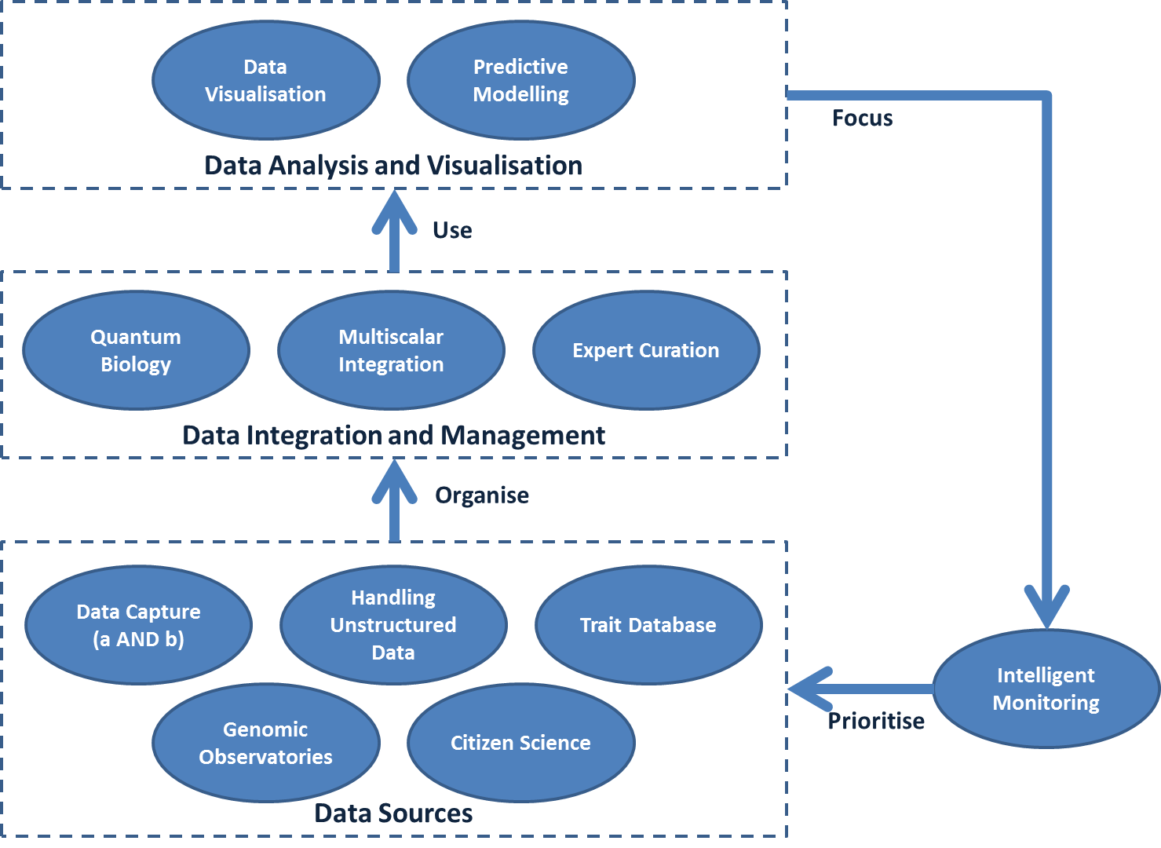
GBIC 2012 Discussions

Slide 7
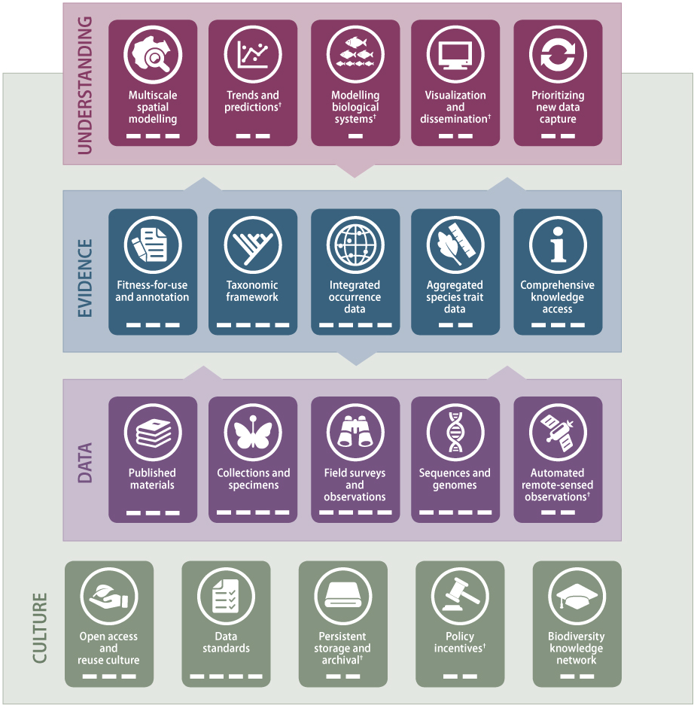
Global Biodiversity Informatics Outlook
http://biodiversityinformatics.org/

Slide 8
The GBIO Framework
Assessments and Indicators
Environmental, Climatic and Sociological Data
Understanding
Multiscale Spatial Modelling
Trends & Predictions
Modelling Biological Systems
Visualization & Dissemination
Prioritising New Data Capture
Culture
Evidence
Fitness-for-use & Annotation
Taxonomic Framework
Integrated Occurrence Data
Aggregated Species Trait Data
Comprehensive Knowledge Access
Data
Published Materials
Collections & Specimens
Field Surveys & Observations
Sequences & Genomes
Automated & Remote-sensed Observations
Open Access & Reuse Culture
Data Standards
Persistent Storage & Archival
Policy Incentives
Biodiversity Knowledge Network

Slide 9
The GBIO Framework
Assessments and Indicators
Environmental, Climatic and Sociological Data
Understanding
Multiscale Spatial Modelling
Trends & Predictions
Modelling Biological Systems
Visualization & Dissemination
Prioritising New Data Capture
Culture
Evidence
Fitness-for-use & Annotation
Taxonomic Framework
Integrated Occurrence Data
Aggregated Species Trait Data
Comprehensive Knowledge Access
Data
Published Materials
Collections & Specimens
Field Surveys & Observations
Sequences & Genomes
Automated & Remote-sensed Observations
Open Access & Reuse Culture
Data Standards
Persistent Storage & Archival
Policy Incentives
Biodiversity Knowledge Network

Slide 10
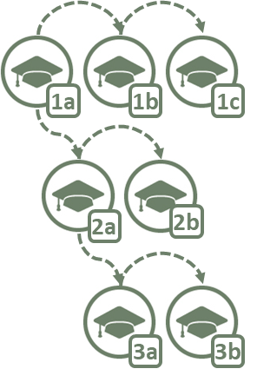
GBIC2: Coordinating Joint Planning
Coordination
Team
Coordinates
Consultation Process
Expert
Group
Draft
Roadmap
Wide
Consultation
Agreed
Roadmap
Governance
Technical Support
Communication
Coordinating Mechanism
Funding and Sustainability
Best Practices

Slide 11
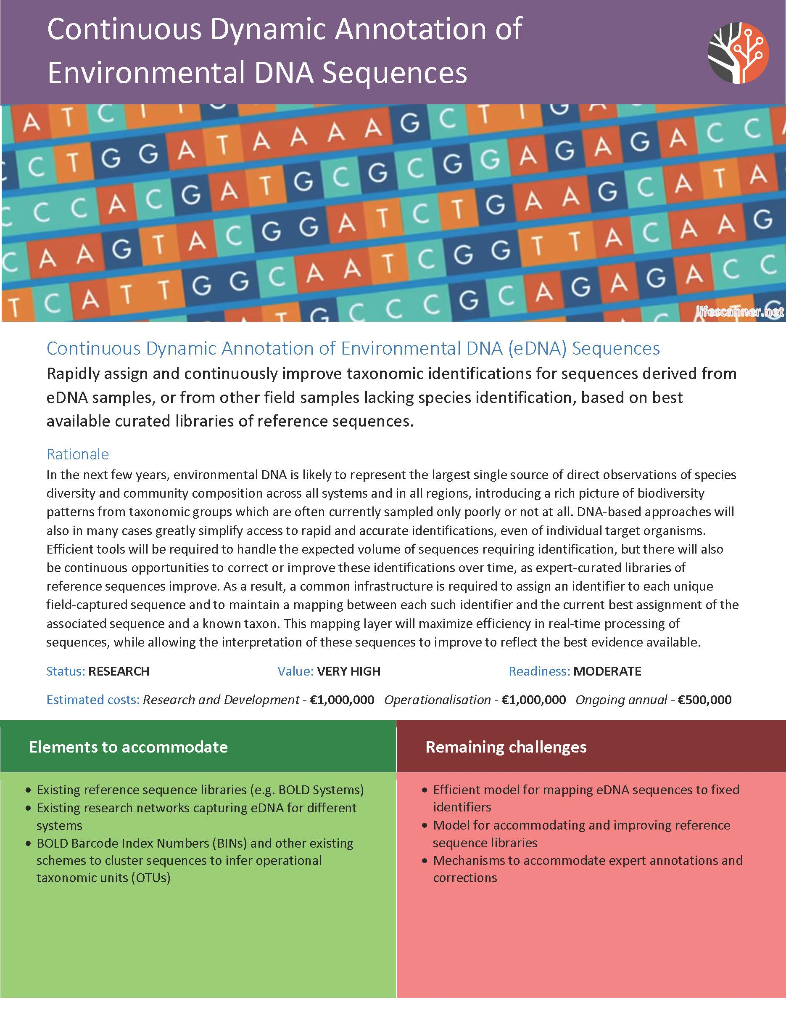
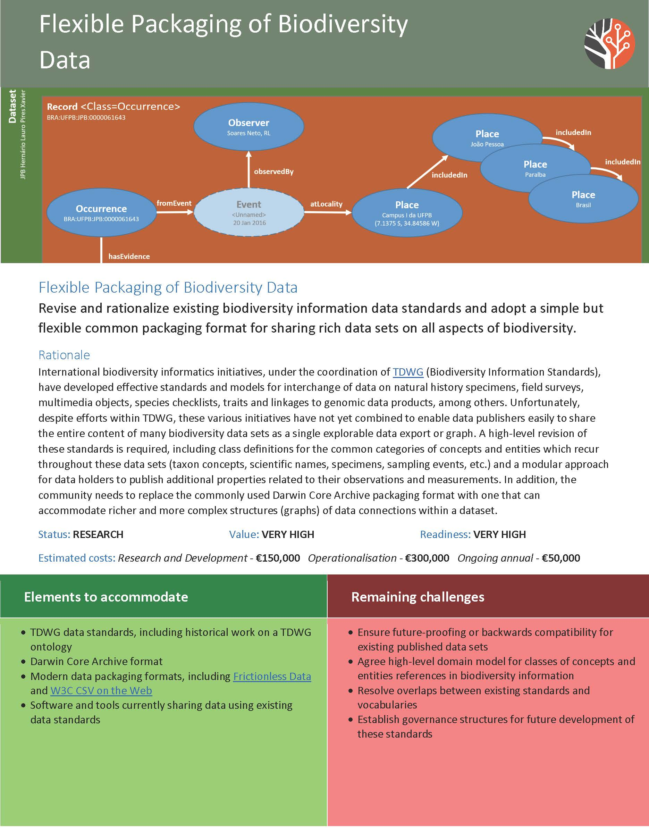
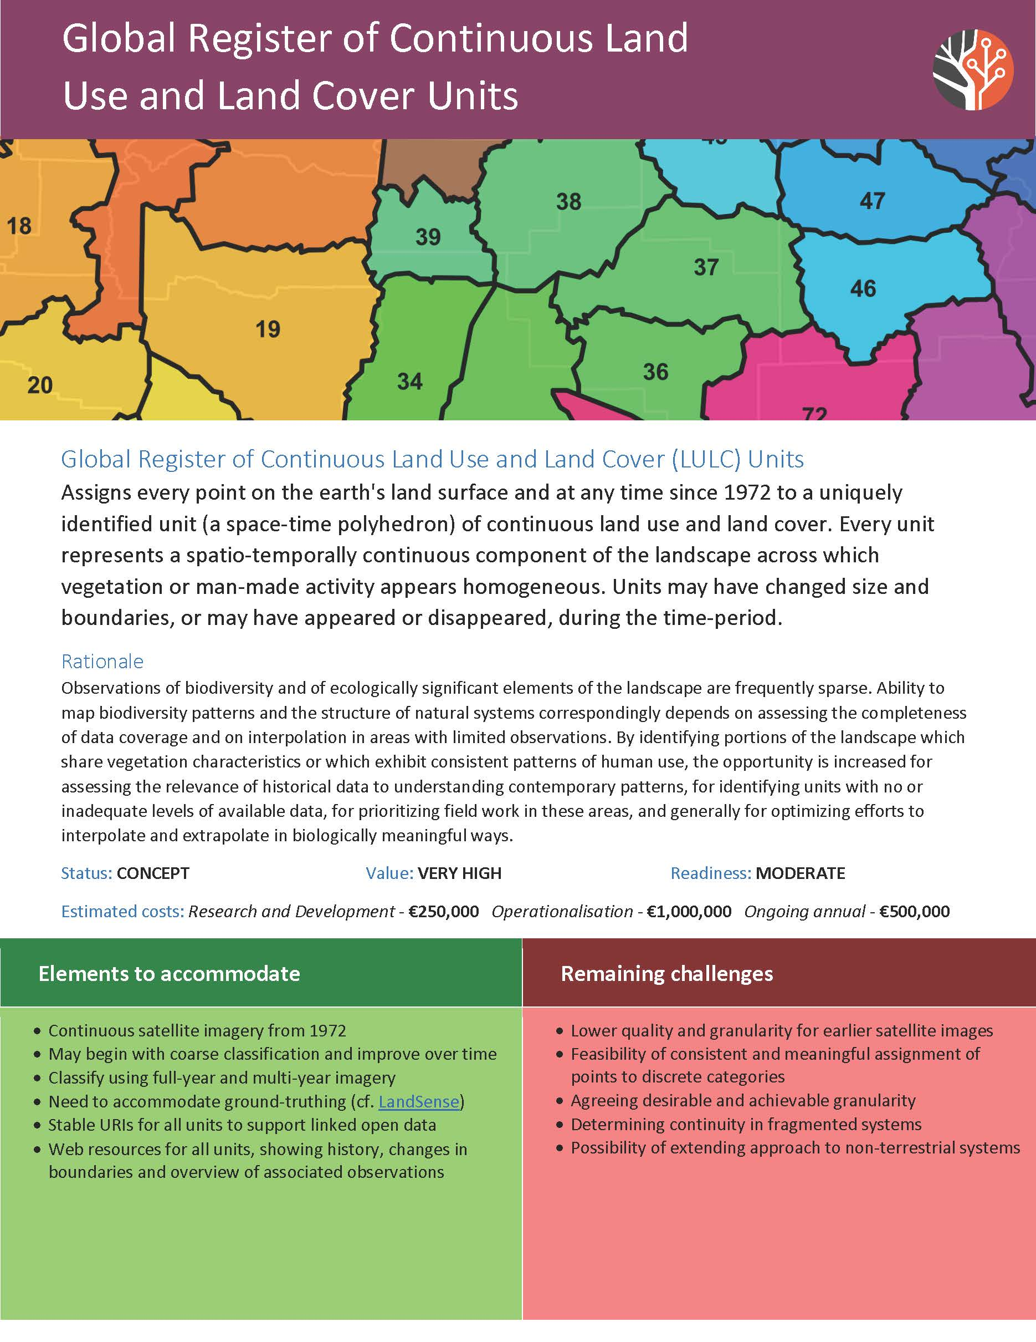
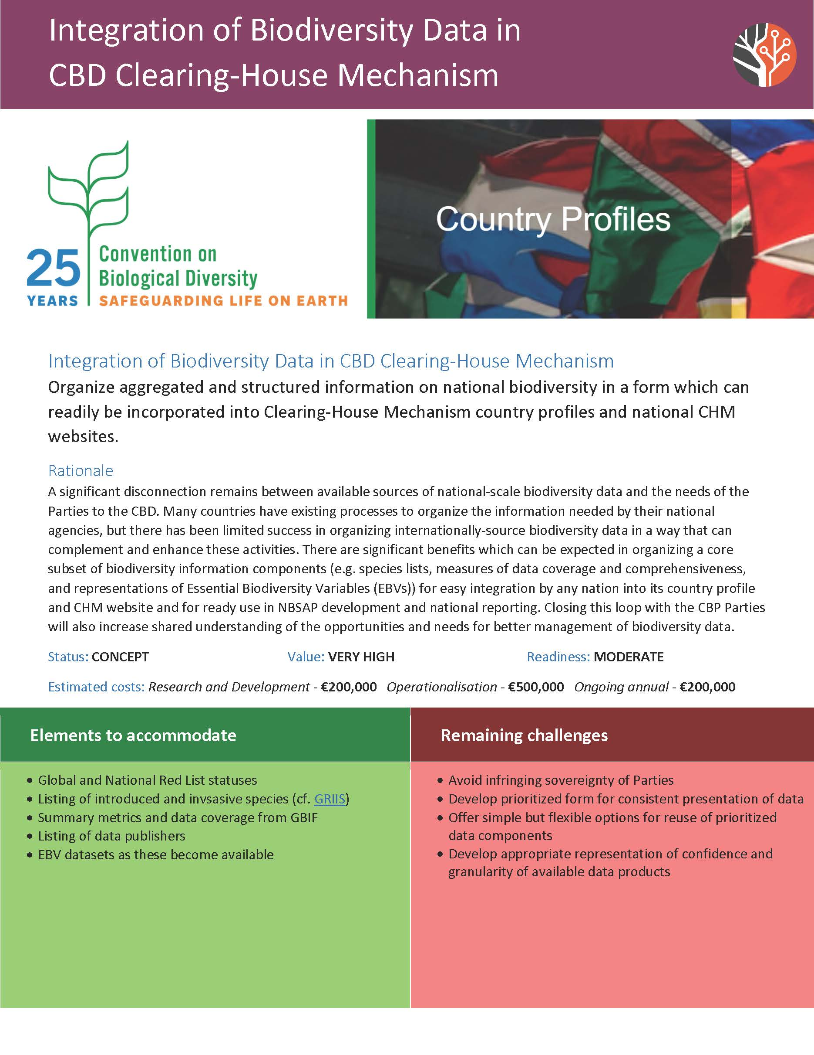
Investment priorities

Slide 12
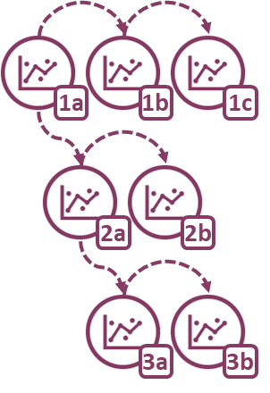
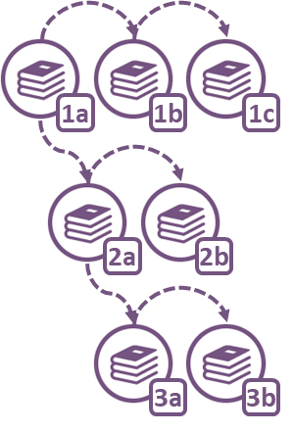
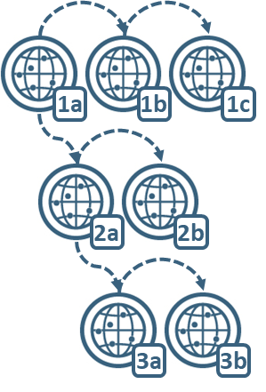
GBIC2: Coordinating JOINT Implementation
€
₽
€
₽
₽
¥
Communicateand Translate Roadmaps
Advise on Standards and Best Practice
Support Proposal Development
Coordinate Letters of Support
¥
¥
Government
Agency
Yes!
是!
£
Coordinates
Professional
Society
¥
Natural
History
Collection
Coordination
Team
Networks and
Consortia
$
$
Computing
Centre
$
$
University
$
$
€
£
€
€
$
Agreed Roadmaps
£
£
Industry
$
Translation icon: Mgalloway / CC-BY-SA-3.0 - Bullet list icon: Chameleon Design, IN / CC-BY-3.0

Slide 13
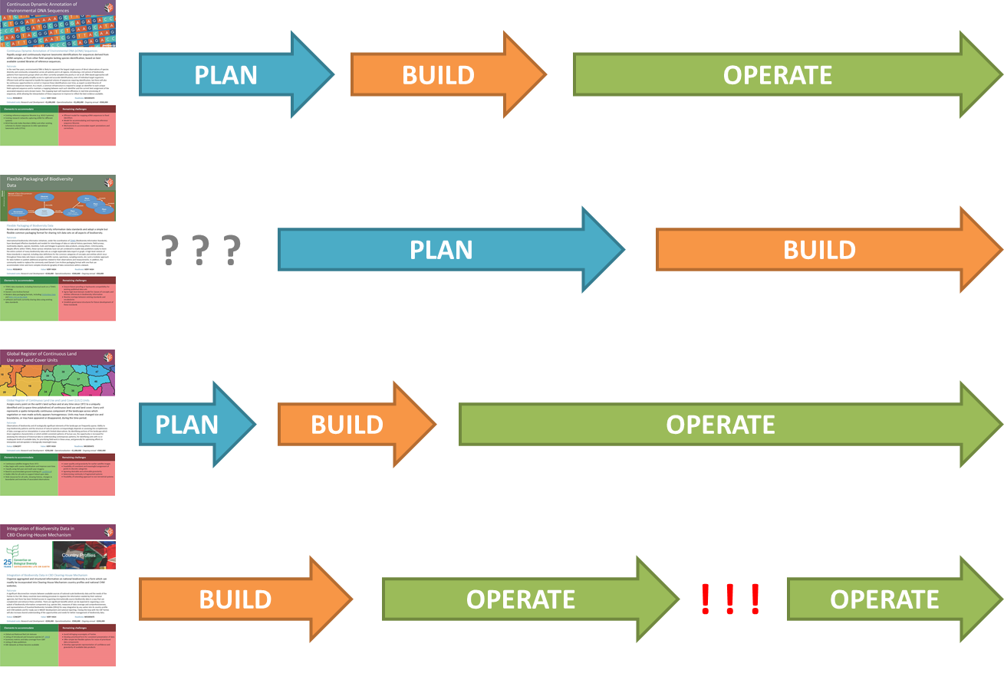
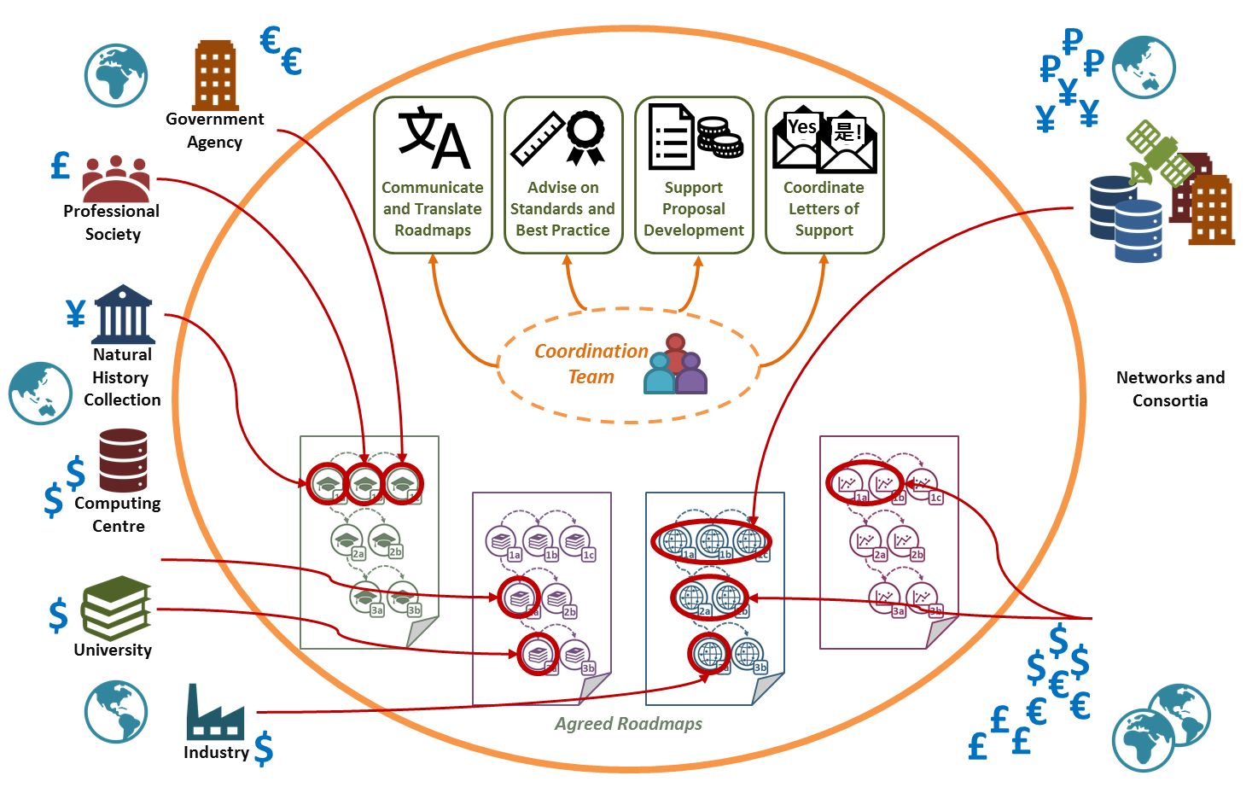
How MUCH COORDINATION IS POSSIBLE?
EASIER
HARDER
Shared vision
Shared language
Shared vision
Shared language
Shared priorities
Shared vision
Shared language
Shared priorities
Shared reporting
Shared vision
Shared language
Shared priorities
Shared reporting
Shared funding
Shared delivery
Shared sustainability

Slide 14
What happens after this week?
Consultation Paper summarising outcomes
Consensus from attendees
Dissenting perspectives
Open questions
Multiple language versions
International consultation on suggested model
Expand buy-in from a broader community
Refine ideas where appropriate
Secure funding to begin implementation
Details depend on adopted model

Slide 15
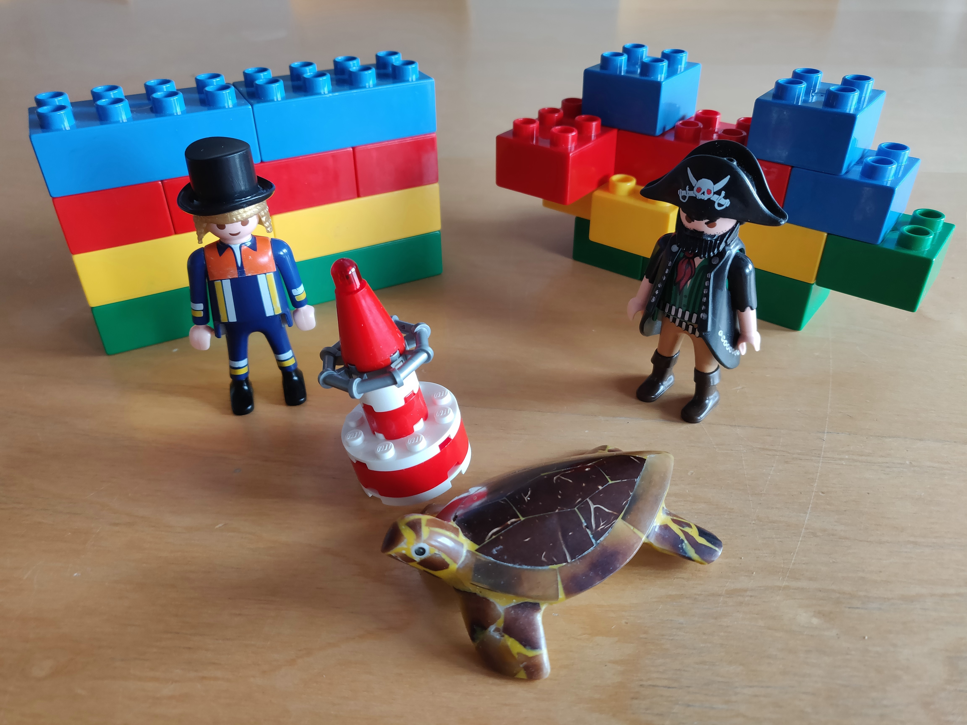
Facilitated Plenary sessions

Slide 16
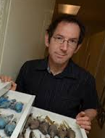
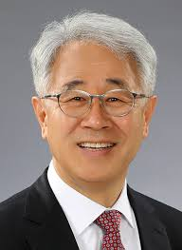
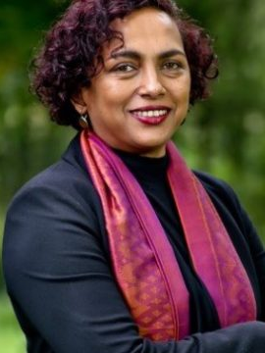
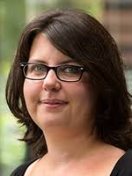
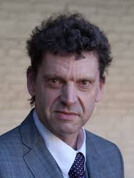
Steering Committee
Brigitte Baptiste
Alexander von Humboldt Institute
Colombia
Rob Guralnick
Florida Museum of Natural History
USA
Donald Hobern
GBIF Secretariat
Denmark
Eun‐Shik Kim
Kookmin University
Korea
Isayvani Naicker
African Academy of Science
Kenya
Laetitia Navarro
German Centre for Integrative
Biodiversity Research (iDiv)
Germany
Edwin van Huis
Naturalis
Netherlands

Slide 17
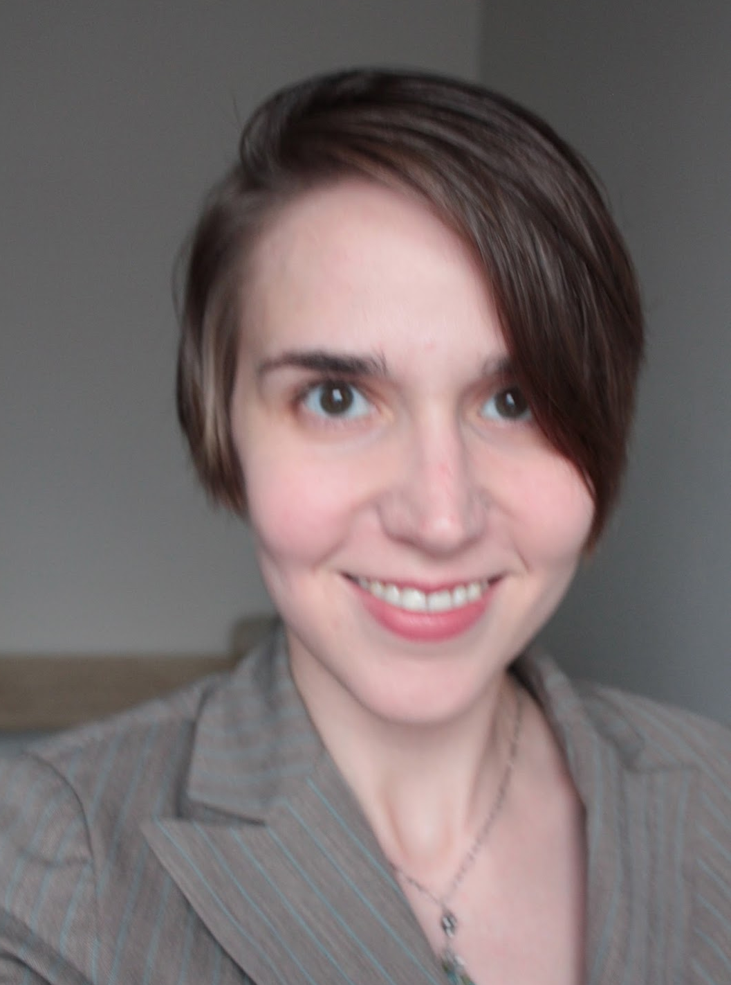
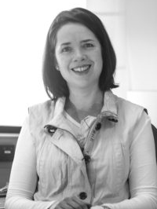
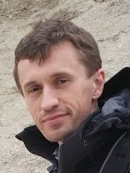
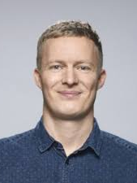
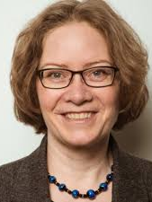
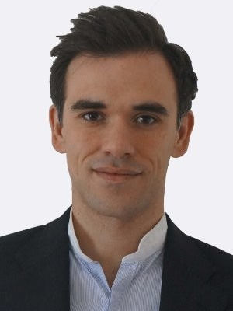
Session Facilitators
Michelle Price
Conservatoire et Jardins Botaniques
de Ville de Genève
Switzerland
Carolyn Sheffield
Smithsonian Libraries
USA
John Wieczorek
University of California, Berkeley
USA
Melodie McGeoch
Monash University
Australia
Dmitry Schigel
GBIF Secretariat
Denmark
Daniel Noesgaard
GBIF Secretariat
Denmark
Andrea Hahn
GBIF Secretariat
Denmark
Andrew Rodrigues
GBIF Secretariat
Denmark

Slide 18
SPONSORS

